Slide 1
Project Pitch: Tetrahedral Voxel Meshing Toolkit
Presented by Cassette Costen
Games Development Project

Slide 2
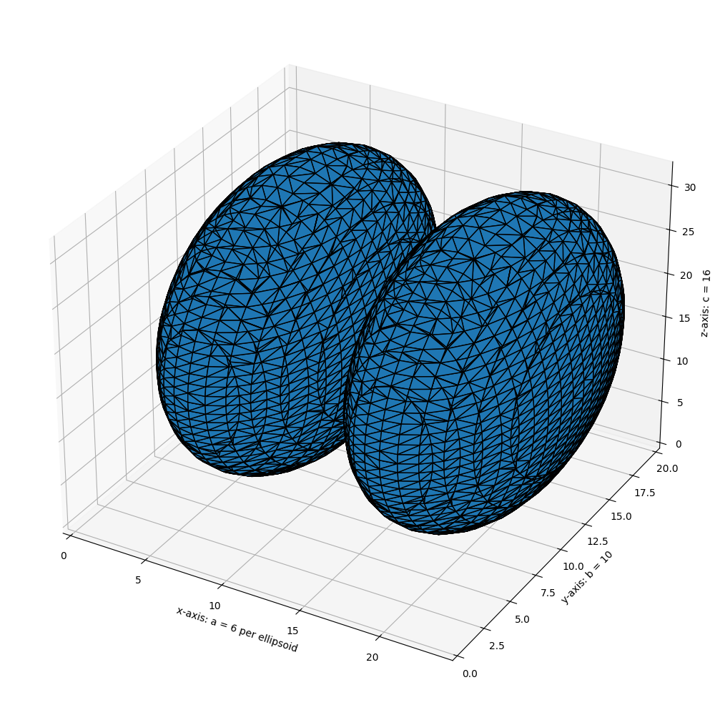
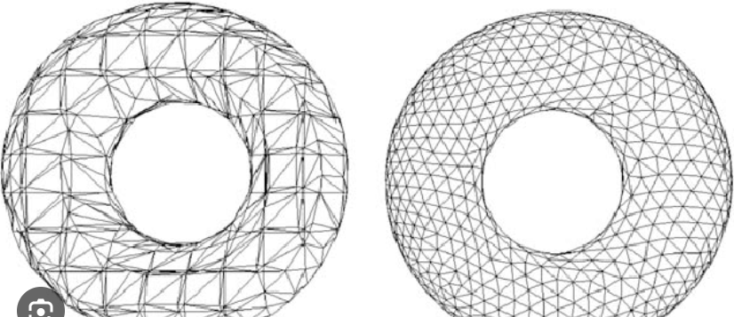
Project Problem
This is a template that you can adapt for your own presentation. Use these slides as a guide for what you should include.
A simple-to-use toolkit for smooth voxel mesh generation would be extremely useful for terrain generation tasks.
For example, generating procedural 3D asteroids using noise functions
Most remeshing tools use marching cubes, which produces distinctly *ugly* results
This is mostly as a result of having inconsistent triangle area (which is also a problem for rendering efficiency)
The project would need to use a different mesh generation algorithm (such as marching tetrahedra), as well as employing post processing to the mesh to resolve this
For usefulness the project should provide the ability to update a larger surface in individual chunks, and ideally I'd like to implement this as both a CPU algorithm and a GPU compute shader, and be able to handle LODs for lower-res terrain/geometry if needed. And obviously it should be fast
Ugly ugly tiny triangle marching cubes (skimage 0.23.2 documentation)
Torus triangulation with marching tetrahedra (researchgate)

Slide 3
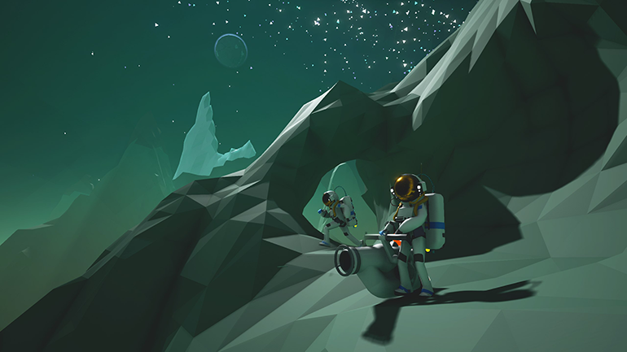
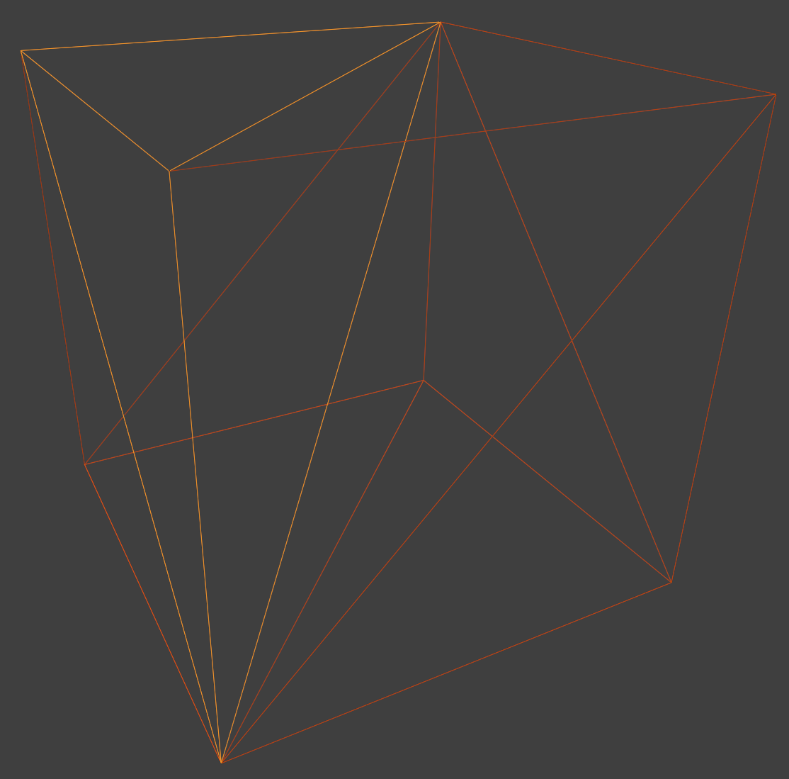
Key Influences
My key visual inspiration here is ASTRONEER and its beautiful (realtime deformable) low-poly triangle-based terrain
I've read several instances of discussion around different voxel meshing methods, and marching tetrahedra (aside from typically producing cleaner triangle geometry) requires slightly less computation per unit, involves fewer geometric combinations, and eliminates certain ambiguity problems present in marching cubes
I want this to be a drop-in solution for projects, a simple library/add-on that you can just invoke a static class to generate a mesh from a scalar field (using a user-defined function)
Recreation of the arrangement of tetrahedra in a cube-based marching tetrahedra setup in blender. There is a better (diamond) arrangement that I haven't looked into yet!

Slide 4
Industry Relevance
Be sure to include where you have found these job listings, try all avenues-LinkedIn and Art Station are great places to start.
In the first 5 pages of Linkedin search, only 2 jobs were actually reasonably relevant (graphics programming) to the subject area, though both of these roles focus on the low engine/driver level development which wouldn’t typically deal with a project like this, being halfway aligned between technical art and graphics programming
This role probably comes closest to being relevant (https://www.linkedin.com/jobs/view/4297527612/); it's a tech art role which makes specific mention of researching new technologies or techniques to improve the game and ensure it meets its technical goals
In general this project does require being able to parse mathematical papers relating to graphics and understand techniques for manipulating 3D geometry, which are applicable to both graphics programming and technical art. Specific to the role mentioned above for instance, I would literally be researching and developing a toolkit to generate better-looking geometry via voxel meshing

Slide 5

Research Plan
I'll probably be reading a bunch of math papers for this project (I already have my basic resources and they're listed on the next slide), as well as resources relating to GPU compute shader programming and sorting algorithms (for mesh post-processing and vertex merging)
Google Scholar and similar tools will probably be my main starting point for research
The research will involve experimentation to some extent, to see which techniques are worth implementing and which produce desired results
From looking at existing papers, the main technical obstacle I see will be having the algorithm achieve (ideally) realtime performance. The key to this will likely be breaking down mesh computation into individual chunks which can be carried out concurrently

Slide 6
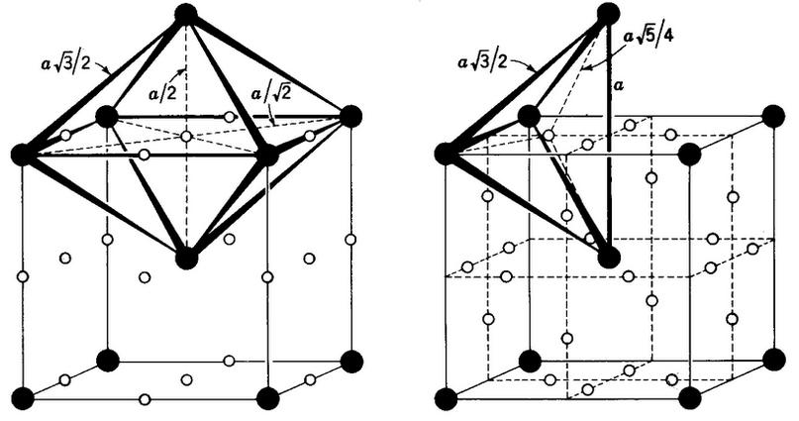

Examples of key literature and research
Regularised marching tetrahedra (https://www.sciencedirect.com/science/article/abs/pii/S009784939900076X)
Diamond crystal lattice (https://gist.github.com/d3x0r/5633f0548f4d7b283f8bab19e022acad)
Marching tetrahedra visualised (https://paulbourke.net/geometry/polygonise/)
In general I will be looking for 'isosurface extraction' since MT (like MC) is an isosurface extraction technique (i.e. computing a surface for which all points evaluate to the same value in the function defining the surface, iso=same, surface=surface)
Username: staffs@gdcvault.com
Password: StaFFs25VA724# (Password is case sensitive)
Page: https://gdcvault.com

Slide 7
Deliverables and Project Planning
Deliverables - a C# toolkit (probably in the form of a class with a set of static functions for mesh generation and post-processing) that Does The Thing
I'll use a kanban board, which I'm very familiar with at this point, to manage the tasks/scope of the project and estimate the time each task takes
Key milestones - achieve basic mesh generation; implement vertex normal generation; implement post-processing techniques; implement efficiency measures (e.g. pre-caching scalar field); perfect library interface for use in any project (including customisation of generation options). Hard to know what the milestones will be before having done the project!
Time allocation - research 3-5 weeks (aiming to be mostly done with foundational research early on, but research will likely continue as appropriate), development 15 weeks (I assume we are expected to work nonstop through the holidays as usual, so this will give extra leeway), hopefully leaving a few weeks to finalise the writeup, which I will be adding to continuously during the project
Gantt chart on following slide

Slide 8
